Slide 1
Anesthesia for diseases of the RS
Biruk T.

Slide 2
Management of anesthesia
Occurrence of severe bronchospasm is 0.2 upto 4.2 % under all GA
Risk factors for the development of bronchospasm includes
Type of surgery (abdominal and oncologic surgeries)
Recent asthmatic attack

Slide 3
Effect of GA
General anesthesia increase the airway resistance due to
depression of cough reflex
impaired mucocilliary function
decreased palatopharyngeal muscle tone
depression of diaphragmatic function

Slide 4
Effect of GA
Increased fluid in the airway wall
Endotracheal intubation
Activation of the parasympathetic nervous system
Release of neurotransmitters of pain such as substance P & neurokinines

Slide 5
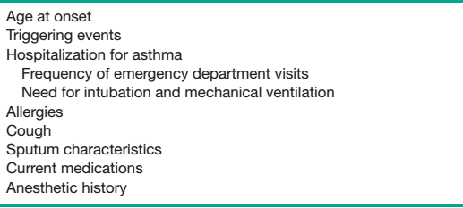
Characteristics of asthma to be evaluated preoperatively

Slide 6
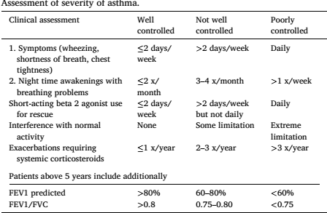
Severity assessment

Slide 7
Preoperative assessment
Severity
Effectiveness of treatment
Pharmacological management
The need for additional therapy before surgery
Characteristics of asthma

Slide 8
Preoperative evaluation
Goal of preoperative evaluation:
To formulate anesthetic plan that prevent or blunt expiratory airflow obstruction
Preoperative evaluation begins with a history to elicit the severity and characteristics of the patient’s asthma
On PE the general appearance of the patient and any use of accessory muscles of respiration should be noted
Auscultation of the chest to detect wheezing or crepitation is important

Slide 9
Investigation
Blood eosinophil counts often parallel the degree of airway inflammation
Airway hyper reactivity provides an indirect assessment of the current status of the disease
PFTs (especially FEV1) performed before and after bronchodilator therapy may be indicated inpatients scheduled for major surgery
A reduction in FEV1 or FVC < 70% of predicted
FEV1:FVC < 65% of predicted, usually considered a risk factor for perioperative respiratory complications

Slide 10
Investigation
PFT/Spirometry: helps for chronic and uncontrolled asthmatic patients
To determine airflow obstruction is at least partially reversible after use of bronchodilators
Reversibility is indicated by an increase of at least 12% in FEV1 from baseline.
In adults, an increase in FEV1 of > 200 mL from baseline also constitutes reversibility

Slide 11
Investigation
Electrocardiogram (ECG): asthmatic patients may show :
Right atrial or ventricular hypertrophy
Acute strain
Right axis deviation
Right bundle branch block
we should routinely check an ECG during and after the acute attack for comparison
Notes:
The normal QRS axis should be between -30 and +90 degrees. Left axis deviation is defined as the major QRS vector, falling between -30 and -90 degrees. Right axis deviation occurs with the QRS axis and is between +90 and +180 degrees

Slide 12
Investigation
Chest x-rays: rule out pneumonia or heart failure
Hyperinflation and increased lung markings, bronchial thickening are common radiographic findings of asthma
Has little value in formulating changes in therapy

Slide 13
Reversible component of asthma
Preoperative physiotherapy
Antibiotics
Bronchodilators
Ventilation and oxygenation issue can be investigated using ABG (arterial blood gas analysis)
Continue anti- inflammatory & bronchodilator therapy perioperatively
‘’stress dose’’ hydrocortisone or methyl prednisolone – if patient is taking corticosteroid therapy for ≥ 6 months

Slide 14
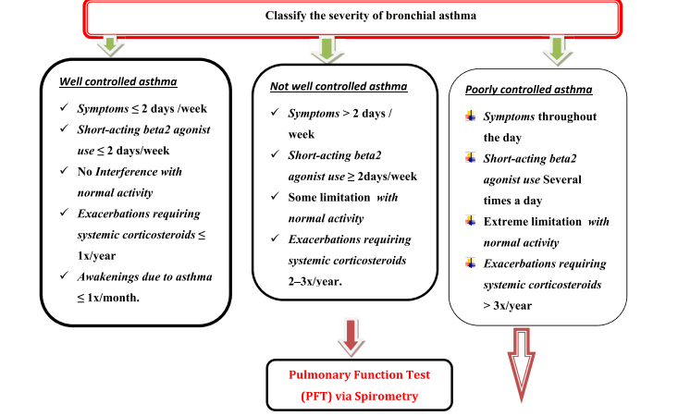
Requirement for PFT

Slide 15
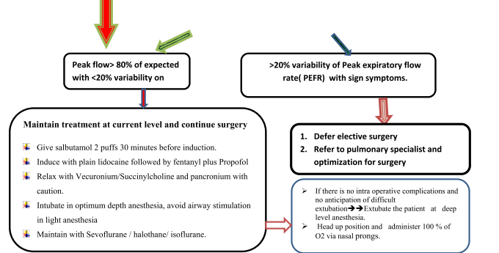

Slide 16
In selected patients a preoperative course of oral corticosteroids may be useful to improve overall lung function
Patients should be free of wheezing
PEFR(peak expiratory flow rate- > 80% of predicted or at the patient’s personal best value before surgery

Slide 17
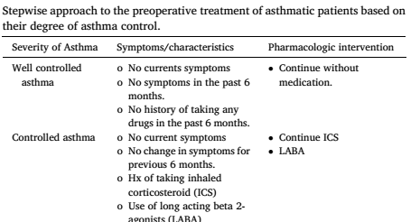
Preoperative control

Slide 18
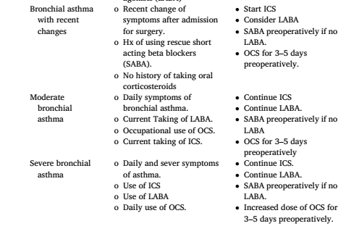
Preoperative control

Slide 19
Induction
Deep anesthesia with IV anesthetics
Ventilate the lung IAAs after induction of GA
Use of ultrashort acting opioids (remifentanil)
Avoiding bronchospasm as it is life threatening complication that can lead to hypoxia, irreversible brain damage ultimately death due to inability to ventilate
Light plane of anesthesia with airway instrumentation leads to bronchospasm

Slide 20
Induction
Regional anesthesia is preferred technique to avoid airway instrumentation
High sensory block causing sympathetic block to result in bronchoconstriction is unfounded
propofol is preferred induction drug for hemodynamically stable patients
If patients hemodynamics is unstable ketamine can be a preferred choice of IV anesthetic drug
Sevoflurane better than isoflurane and desflurane in terms of pungency to avoid stimulating airway reflex

Slide 21
Opioids
Another option is giving IV lidocaine 1.5 mg/kg several minute before airway instrumentation
Opioids help in providing deeper level of anesthesia to suppress airway reflex
Most opioids release histamine that provide a risk factor for the development of bronchospasm
Fentanyl and its alike are safe
Remifentanil is the best due to its ultra short acting effect

Slide 22
Muscle relaxants
NDMR can be used for skeletal muscle relaxation
As much as possible its better to use NDMRs that doesn't cause release of histamine
Mivarurium, Atracurium and tubocurarine are NDMRs that are associated with significant histamine release

Slide 23
Muscle relaxants
NMBDs agents cause allergic reactions in the OR
Even though, suxamethonium can releases low levels of histamine
Useful for the asthmatic that needs a RSIs in low resource settings without significant morbidity & mortality
Vecuronium, rocuronium, and cis-atracurium are safe for use in asthmatics during induction and maintenance
Pancuronium which releases low levels of histamine - used safely in asthmatics with little morbidity

Slide 24
Reversal of NMBDs
Reversal of neuromuscular blockade with anticholinesterase drugs could precipitate bronchospasm due to postganglionic cholinergic receptors in airway smooth muscle
But it doesn't predictably occur due to the use of anticholinergic drugs since they have Broncho-dilating effect

Slide 25
Warm and humidified oxygen/air should be used at all times
Specially for patients with exercise induced asthma important to decrease trans-mucosal heat loss
Adequate hydration of patients with fluid is important to avoid mucus plugging in the airway to remove them easily
The use of LMA is better than ETT to avoid occurrence of bronchoconstriction in patients who are not at increased risk of reflux or aspiration
Light stage of anesthesia may be confused with bronchospasm deeper level of anesthesia and use of muscle relaxant can help to rule out between two

Slide 26
Deep & smooth extubation is recommended if airway difficulties were not encountered during induction
When difficulty is anticipated the patient may be taken to the PACU as intubated with opioids administered to facilitate tolerance to the ETT
When the patient is awake & possesses appropriate airway reflexes, Extubate with IV lidocaine to prevent bronchospasm

Slide 27
Desired level of arterial O2 & CO2 removal can be secured with MV with providing prolonged expiratory time to avoid air trapping and occurrence of intrinsic PEEP
This can be facilitated by using smaller tidal volumes than usual
when situations doesnt intel to extubate patients to extubate patients deep awake extubation with use of inhaled bronchodilators or IV lidocaine

Slide 28
Bronchospasm can be caused by light anesthesia sign and symptoms are :
High peak airway pressure
Upsloping of the end tidal CO2 waveform &
Wheezing
Desaturation

Slide 29
Treatment of intraoperative Bronchospasm
Deepening of anesthesia – IAA & Propofol
Rapid acting ß2 agonists- albuterol via the ETT
IV corticosteroids
Adrenaline
Magnesium

Slide 30
Asthma in Emergency Surgery
Weigh the risk between risk of aspiration & triggering significant bronchospasm
No sufficient time to optimize bronchodilator therapy prior to surgery
Regional anesthesia is a good option if it is suitable for the site of the surgery

Slide 31

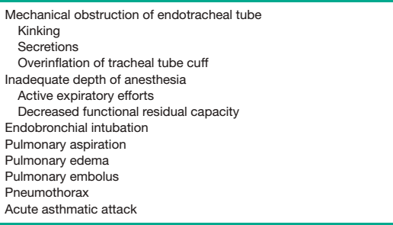


Slide 32
Bronchospasm should be differentiated from anaphylaxis by the absence of:
Hypotension
Flushing
Rash and/or
Angioedema

Slide 33
Postoperative management
Reversal of NMBDs
Neostigmine may contribute to bronchospasm by inhibiting breakdown of acetylcholine
Sugammadex can be used to reverse rocuronium & vecuronium without risk of bronchoconstriction
Research showed no significant difference b/n awake versus deep extubation as it is related to PARE(perioperative adverse respiratory events)
Monitor very closely &
Return to the preoperative asthma regimen ASAP

Slide 34
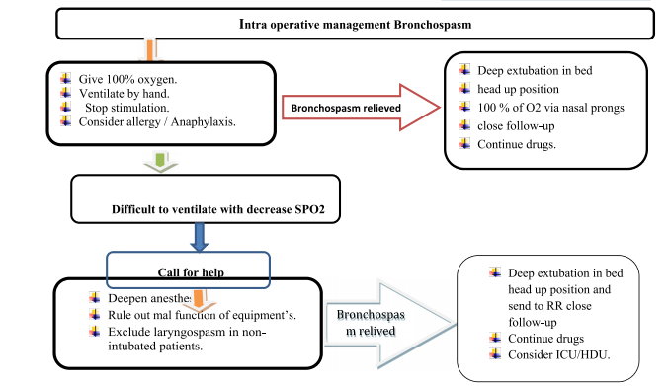

Slide 35
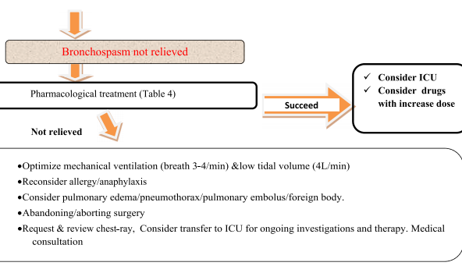

Slide 36
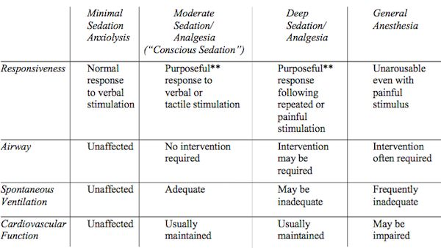
Level of Anesthesia

Slide 37
COPD: progressive loss of alveolar tissue and progressive non reversible airflow obstruction
The third leading cause of death globally according to WHO
Pulmonary elastic recoil is lost
Alveolar and bronchial destruction
Due to inhalation or exposure to chemical substances like cigarette smoke

Slide 38
Risk factors
Cigarette smoke
Occupational exposure to chemicals in coal mining, gold mining & textile industry
Indoor and outdoor pollution
Recurrent childhood respiratory infections
Low birth weight

Slide 39
Challenges
Intraoperative and postoperative pulmonary complications
Increased hospital stay
Increased mortality rate

Slide 40
COPD
Pathologic deterioration in elasticity or recoil within the lung parenchyma which helps the airway to be open
Pathologic changes that decreases rigidity of bronchiole wall and predispose them to collapse during exhalation
Increase in gas flow velocity in narrowed bronchiole which lowers the pressure inside them that leads to airway collapse
Active bronchospasm and obstruction resulting in increased pulmonary secretion
Destruction of lung parenchyma, enlargement of air sacs & development of emphysema

Slide 41
Sign and Symptom
Dyspnea on exertion or at rest
Chronic cough
Chronic sputum production
Expiratory wheeze
Decreased breath sounds
Periods of worsening symptoms secondary to acute worsening in airway flow
As expiratory flow obstruction increase in severity : tachypnea & prolonged expiratory phase

Slide 42
Diagnosis
On the history dyspnea & chronic fatigue
Exposure to the risk factors - smoke & chemicals
COPD can not be definitively diagnosed without PFT

Slide 43
Pulmonary Function Test
Decreased FEV1: FVC
Greater decrease in FEF 25-75% of Vital capacity
FEV1:FVC <70% which is not reversible or bronchodilators confirms the diagnosis
Increase in FRC and TLC

Slide 44
Increase in RV is secondary to :
Slowing of expiratory airflow
Gas trapping behind prematurely closed airways

Slide 45
This pathologic ''advantage'' of COPD patients with increased RV & FRC is due to
Enlarged airway diameter
Increased elastic recoil for exhalation
Leads patients to:
Have greater cost of increased work of breathing at
Higher lung volumes

Slide 46
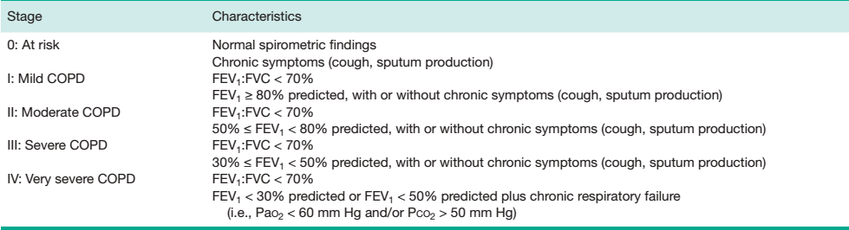
GOLD Spirometric Criteria for COPD Severity (Based on Postbronchodilator FEV1 Measurement)

Slide 47
Chest X-ray
Minimal abnormalities even in severe COPD
Hyperlucency due to arterial vascular deficiency in the lung parenchyma
Hyperinflation(flattening of the diaphragm with loss of its dome shape appearance)
Vertical cardiac silhouette(which is assign of emphysema)
If bullae is diagnosis of emphysema is certain
Small percentage of patients with emphysema have bullae

Slide 48
CT scan
More sensitive test but used mostly to screen lung Ca
To evaluate condition of the lung before surgery
It shows bronchial wall thickening
Alveolar septal destruction & airspace enlargement

Slide 49
Arterial blood gas analysis
Remain normal until COPD is severe
PaO2 doesn't decrease until FEV1 is <50%
PaCO2 may not increase until FEV1 is even lower

Slide 50
Treatment
Goal of treatment is to slow progression of the disease & improve quality of life
main focus are smoking cessation and long term oxygen administration
it helps to alter the natural history of the disease
Cessation of smoking
↓ disease progression
Alter natural history of COPD
↓ mortality by 18%
↓ or stop the symptoms of chronic bronchitis
↓ accelerated loss of lung function

Slide 51
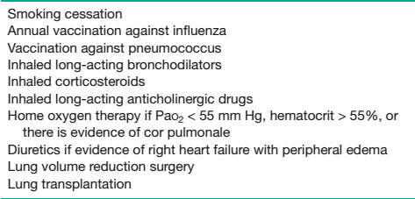
Treatment of COPD

Slide 52
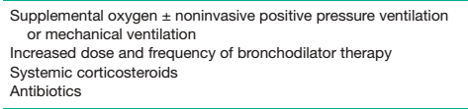
Treatment of exacerbation

Slide 53
Long term oxygen administration
indicated if PaO2 is <55 mmHg & Hct is > 55%
presence of corpulmonale
to achieve PaO2 > 60 mmHg
delivered with nasal cannula at 2 L/min can be titrated with ABG or pulse oximeter
Oxygen therapy is effective than drug therapy
To decrease pulmonary vascular resistance
Pulmonary hypertension can be attenuated with this
Can alter Erythrocytosis

Slide 54
Drugs -
Long acting beta 2 agonists,
Inhaled corticosteroids
Long acting cholinergic drugs
Drug therapy reduces dyspnea & increase FEV1
Decrease exacerbation of COPD by 25%

Slide 55
Diuretics can be administered if the presence of RV dysfunction or corpulmonale is suspected
Be careful as it induces decrement in chloride which leads to hypochloremic metabolic alkalosis
which depress ventilatory drive & chronic CO2 retention
Physical exercise increase exercise capacity of patients but has no change in the PFT
Prompt deconditioning occurs when PE is discontinued

Slide 56
Lung volume reduction surgery
For patients who are not responding for maximal medical therapy
Who have regions of over distended, poorly functioning lung tissue
It helps to have normal areas of the lung to expand & improve lung function and quality of life
Approach for the surgery is through VATS or median sternotomy

Slide 57
Proposed mechanism for improvement after the surgery
↑ in elastic recoil and increase in expiratory airflow
↓ degree of hyperinflation which improves chest wall and diaphragmatic mechanics
↓ in the non uniformity of regional ventilation and perfusion which improve:
Alveolar gas exchange
Increase effectiveness of ventilation

Slide 58
The anesthetic management of LVRS (Lung volume reduction surgery)
Uses double lumen tube(DLT)
Decrease positive pressure ventilation
Peak airway pressure < 25 cmH2O

Slide 59
ANESTHETIC MANAGEMENT OF COPD
History that helps to determine: cause, severity & course of COPD
Smoking history, current medication recent use of corticosteroids
Frequency of exacerbation, timing of most recent exacerbation
Exercise tolerance
The need for hospitalization
The need for NIPPV or Hx of mechanical ventilation

Slide 60
Concomitant diseases
COPD is associated with:
Diabetes Mellitus(DM)
Hypertension
Peripheral vascular disease
Heart failure
Lung cancer
Cardiac dysrhythmia
Ischemic heart disease

Slide 61
Long acting bronchodilators
Anticholinergics
Inhaled corticosteroids
Should be continued until the morning of the surgery
Patients should have to be optimized to decrease morbidity & mortality
Value of PFT preoperatively is controversial
ABG & PFT better in predicting pulmonary function after resection
Do not reliably predict the occurrence of PPC in non thoracic surgery

Slide 62
Presence of smoking history, productive cough & wheeze better predict PPCs than spirometric tests
COPD patients undergoing peripheral surgeries do not require PFT, if doubt exists FEV1 is enough
Patients defined as high risk by spirometric measurements
FEV1 < 70% & FEV1: FVC < 65% OR ABG PaCO2 > 45 mmHg
Can undergo surgery including lung resection with acceptable PPC
PFT should be used to optimize patients not predict risk

Slide 63
Indication for preop PFT (including pulmonologist consultation)
Hypoxemia on room air, the need for home O2 without a known cause
Bicarbonate concentration of ≥ 33 mEq/L or PaCO2 ≥ 50 whose pulmonary disease is not evaluated
History of respiratory failure resulting from a problem that still exists
Severe shortness of breath attributed to respiratory disease
Planned pneumonectomy
Difficulty in assessing pulmonary function by clinical sign

Slide 64
7. The need to distinguish between potential causes of significant respiratory compromise
8. The need to determine the response to bronchodilator
9. Suspected pulmonary hypertension
Carefully assess right ventricular function – clinical exam & echo (advanced pulmonary function)
Ventilatory function should be assessed – static condition & dynamic condition – through flow rate
Expiratory flow rates plotted against lung volumes to produce flow volume curves
When flow rates are added during inspiration to these curves flow volume loops are obtained
Notes:
The flow-volume loop (F/V-loop) is a presentation of inhalation and exhalation of air stream volume during inspiration and expiration. It demonstrates the obstructive, restrictive and mixed pattern lung pathology.

Slide 65
The flow rate is zero at TLC before the start of expiration
Once forced expiration begins, the peak flow rate is achieved rapidly, and the flow rate then falls in a linear fashion as the lung volume decreases to RV
During maximal inspiration from RV to TLC, the inspiratory flow is most rapid at the midpoint of inspiration, so that the inspiratory curve is U-shaped

Slide 66
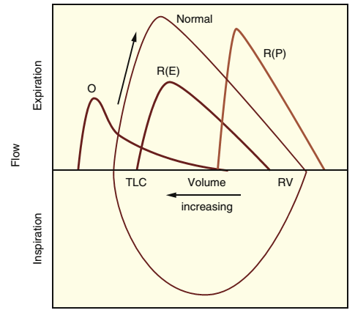
Notes:
Flow-volume curves in different conditions: obstructive
disease, O; extraparenchymal restrictive disease with limitation in
inspiration and expiration, R(E); and parenchymal restrictive disease,
R(P). Forced expiration is plotted for all conditions; forced inspiration is shown only for the normal curve. By convention, lung volume
increases to the left on the abscissa. The arrow alongside the normal
curve indicates the direction of expiration from total lung capacity
(TLC) to residual volume (RV)

Slide 67
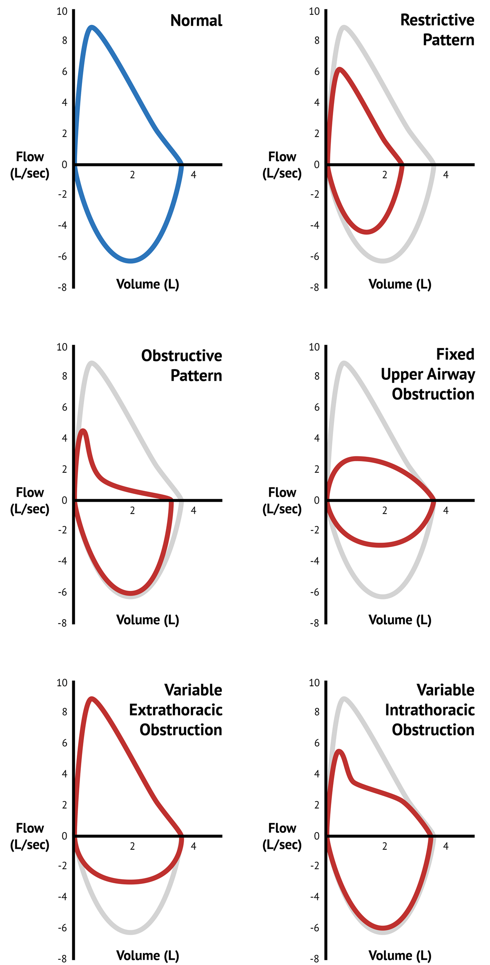

Slide 68
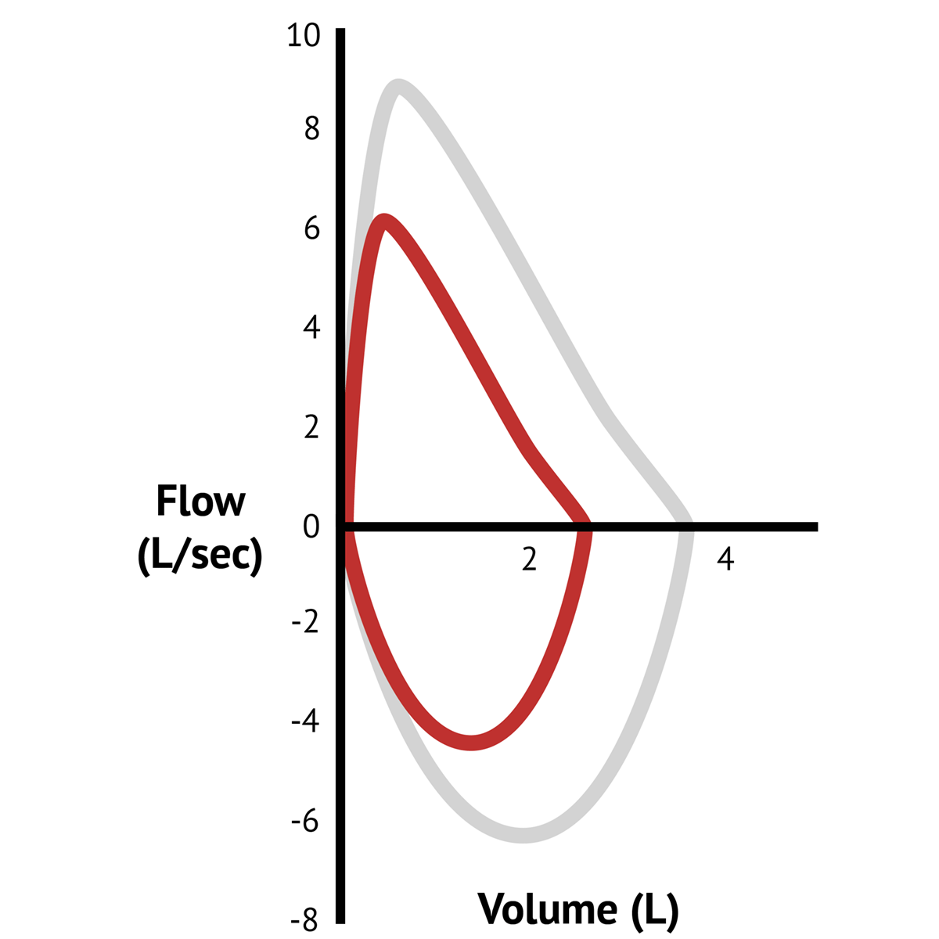

Slide 69
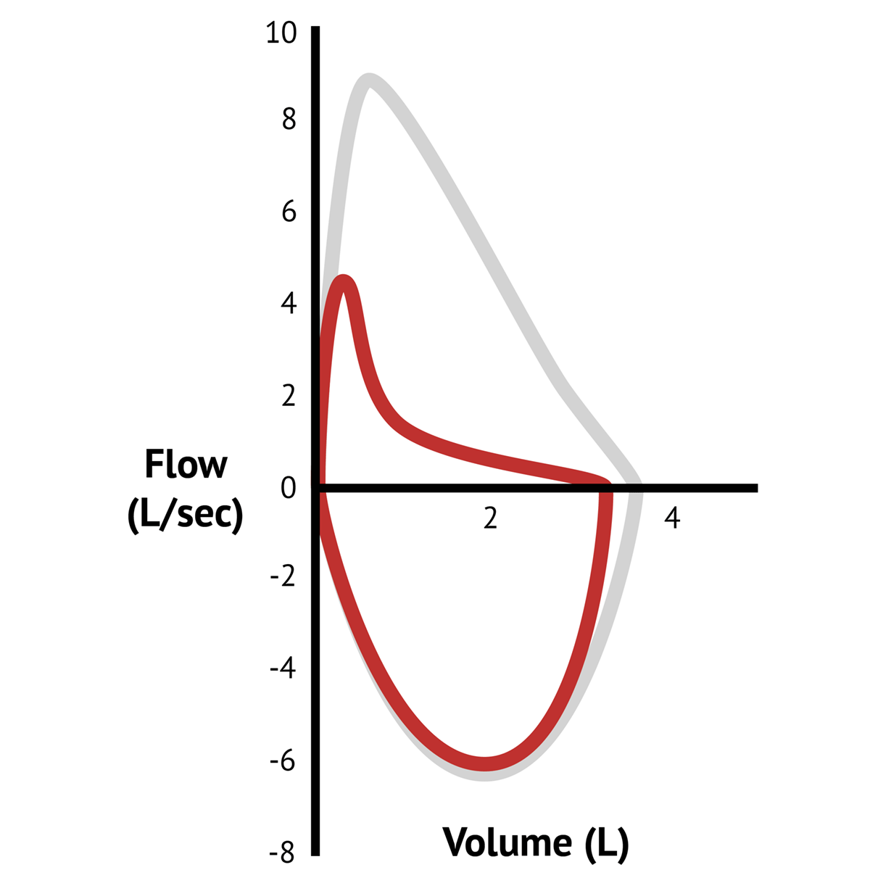

Slide 70
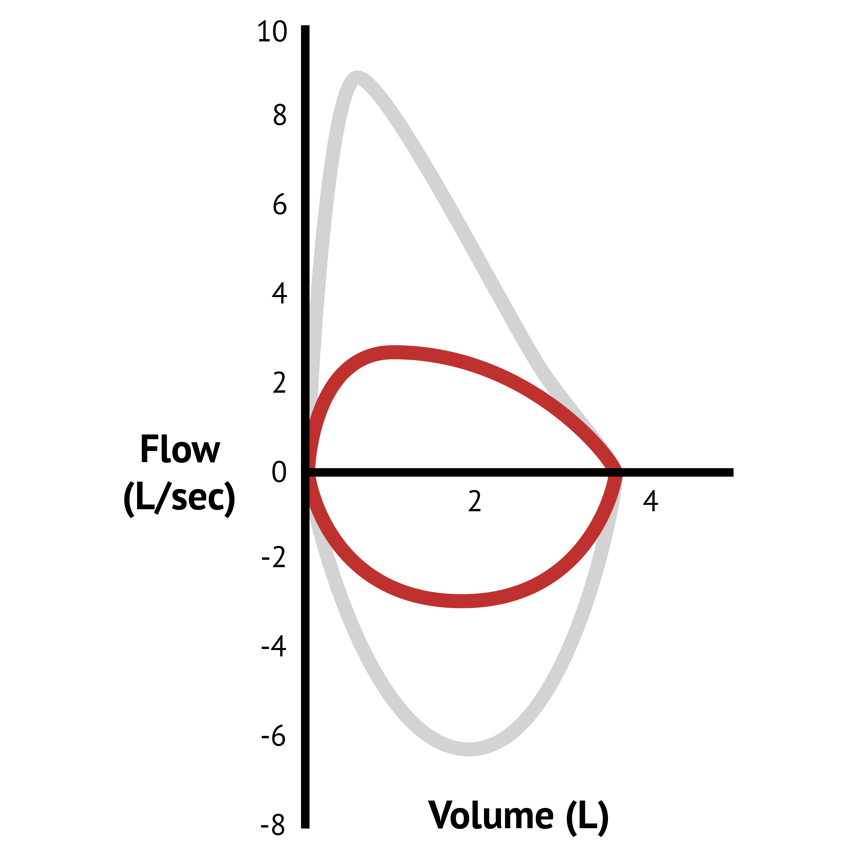

Slide 71
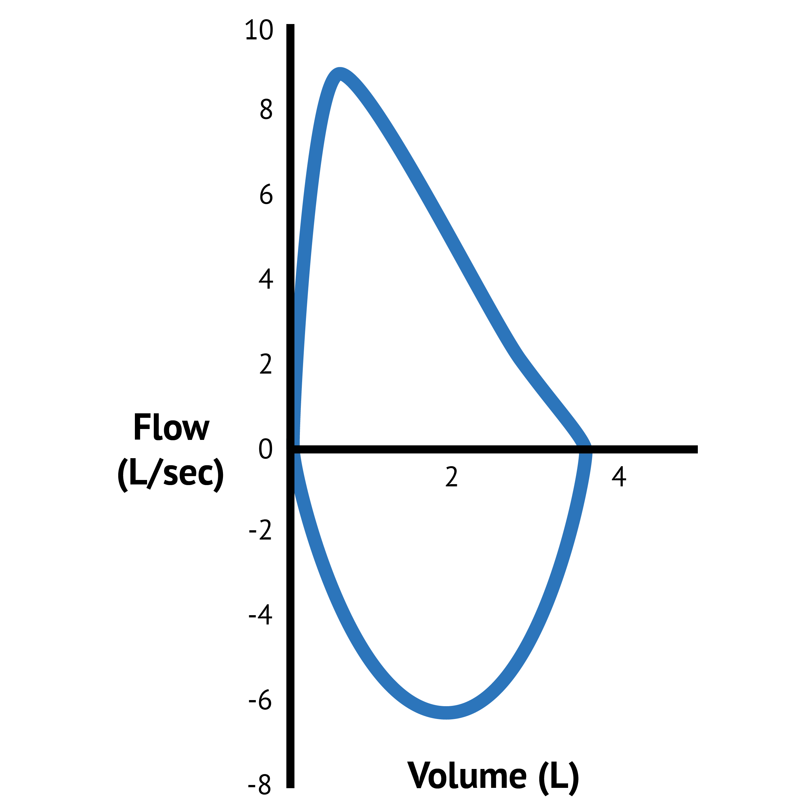
What part of the flow-volume loop is represented below the x axis (the negative deflection?)

Slide 72
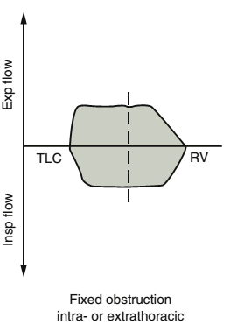
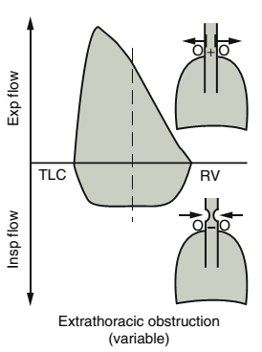
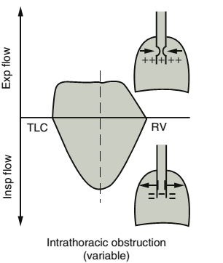

Slide 73
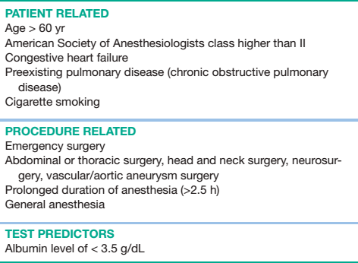
Major Risk factors for PPC

Slide 74
COPD there is a ↓ in the expiratory flow rate at any given lung volume
The expiratory curve is upward due to homogenous emptying of the airways
The RV is increased because of air trapping

Slide 75
Risk reduction techniques
Cessation of smoking
is the single most important risk factor for the development of COPD and death caused by lung disease
The maximum benefit of stopping is not usually seen unless it is stopped > 8 weeks prior
Predictive factors for the development of pulmonary complication
Lower diffusing capacity
>60 pack years smoking
Stopping smoking will make the symptoms of bronchiolitis to resolve
Stop the rapid loss of lung function

Slide 76
Effect of stopping smoking
The adverse effects of CO on oxygen-carrying capacity & of nicotine
on the CVS are short
In 12 hours after stopping of smoking, the Pao2 at P50 ↑ from 22.9 to 26.4 mm Hg
the plasma levels of carboxyhemoglobin decrease from 6.5% to about 1%.
CO have negative inotropic effects
Sympathomimetic effect of nicotine lasts 20-30 minutes
Short term abstinence doesn’t ↓ the incidence of PPC

Slide 77
Intermediate to Long-Term Effects
Cigarette smoking causes - mucus hypersecretion, impairment of mucociliary transport, & narrowing of small airways
Changes comes over weeks of abstinence
Return of normal immune function requires at least 6 weeks of abstinence from smoking
Impair hepatic enzyme/ return of normal function need 6 weeks
There can be disadvantages to smoking cessation in the immediate preoperative period:
Sputum production
Patient fear of the inability to handle stress
Nicotine withdrawal symptoms - irritability, restlessness, sleep disturbances, and depression

Slide 78
Aids in stopping smoking
Counseling
Pharmacotherapy
Nicotine replacement therapy with various delivery systems - patches, inhalers, nasal sprays, lozenges, and gum
The atypical antidepressant bupropion in a sustained-release formulation can also aid in smoking cessation
The drug is typically started 1–2 weeks before smoking is stopped

Slide 79
Nutritional status
Poor nutritional status with a low serum albumin level (<3.5mg/dL) is a powerful predictor of PPC in COPD patients
Malnutrition can increase the risk of prolonged postoperative air leaks after lung surgery

Slide 80
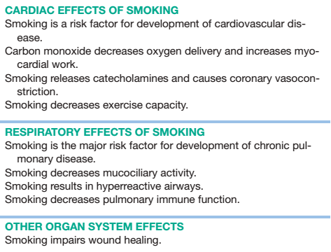
Effects of smoking

Slide 81
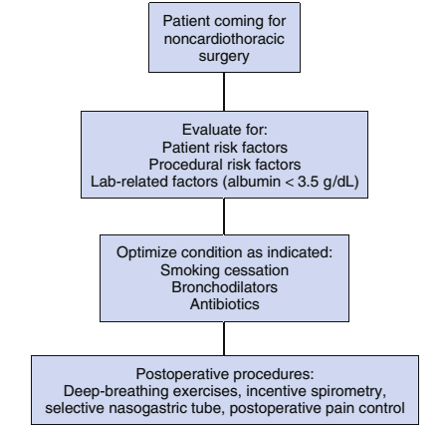
Reducing PPC in non-cardiothoracic surgeries

Slide 82
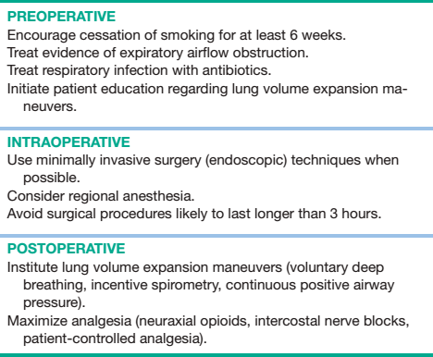
Periop pulmonary complication reduction strategy

Slide 83
Regional anesthesia
Preferred technique
Avoid risk of laryngospasm, bronchospasm, barotrauma & hypoxemia
For extremity, lower abdominal & non peritoneal procedures
GA is reserved for upper abdominal & thoracic procedures
RA via peripheral nerve blockade carries a low risk of pulmonary complications
an interscalene block typically causes ipsilateral phrenic nerve palsy & should be avoided in patients with severe COPD

Slide 84
RA can be employed if only heavy sedation & large dose of anxiolytic is not going to be used
Patients are sensitive for ventilatory depressant effects of such drugs
Sensory block above T6 is not recommended
Above T6 impair ventilation that require active exhalation
ERV, PEFR & MMV are affected – impaired cough

Slide 85
General anesthesia
IAAs are rapidly eliminated – sevoflurane & desflurane
Residual ventilatory depression (early postop) minimal
Bronchodilating effect & treat status asthmaticus
Desflurane increase airway resistance and irritant – incases of severe airway reactivity
Prolonged emergence in patients with significant airway obstruction
Trapping of air also trap IAAs
TIVA with propofol is another option
Remifentanil relieve airway irritation of the ETT
Required level of propofol can be reduced to decrease risk of hypotension

Slide 86
Nitrous oxide cannot be used due to bullae – tension pneumothorax
Limit inspired(FiO2) oxygen that can be used
IAA attenuate regional hypoxic pulmonary vasoconstriction – shunting
Opioids are less useful – prolonged emergence/ventilatory depression
Thiopental & midazolam – have prolonged effect
Humidification of inspired gas
Low gas flow to keep airway secretion moist

Slide 87
Patients are at ↑ risk of lung injury during mechanical ventilation
Goals of MV
Avoid dynamic hyperinflation
Prevent development of autoPEEP
TV 6 – 8ml/kg
Peak airway pressure < 3o cmH2O
FiO2 titrated to keep the SaO2 > 90%

Slide 88
The goals leads to lower levels of inflammatory markers in broncho-alveolar lavage fluid of mechanical ventilated patients
Moderate to severe COPD – cystic air space in the alveoli – risk of rupture once PPV is started
BPF & tension pneumothorax – DDx in hemodynamically unstable
Airtrapping – autoPEEP(intrinsic PEEP) – dynamic hyperinflation – when PPV applied with long expiratory time is not applied

Slide 89
↑ intrathoracic pressure →↓venous return which increase pulmonary artery pressure → RV strain
Inflated lung exert pressure on the heart – limits its ability to expand
During diastole even with adequate preload
Shift of the ventricular septum & ventricular interdependence due to the shared pericardium may cause a distended RV to impinge on filling of the LV

Slide 90
Air trapping during MV
1.Capnography shows that the carbon dioxide concentration does not plateau but is still upsloping at the time of the next breath. This indicates that there is still admixture of air from dead space reducing the ETCO2
2. Direct measurement of flow may be displayed graphically by the ventilator, showing that the expiratory flow has not reached baseline (zero) before initiation of the next breath
3. Direct measurement of the resulting PEEP can be performed using more advanced ventilators that are capable of an expiratory hold

Slide 91
Air trapping – hemodynamic instability, ↓venous return, ↑intrathoracic pressure
Treatment - ↓respiratory rate, ↑expiratory time, disconnect the patient from the ventilator too allow complete exhalation
Patients at risk of bronchospasm – light anesthesia & airway manipulation
Treatment deepen anesthesia with propofol/ IAA
Short acting bronchodilator through the ET tube
Suctioning secretion
IV corticosteroid & epinephrine if initial management fails
Avoid high FiO2 – oxygen species

Slide 92
Surgery, anesthesia, & positioning - airway closure & atelectasis
Alveoli containing 100% oxygen collapse faster than air
Barotrauma – in bullae with high positive airway pressures are required to provide adequate ventilation
In spontaneously breathing COPD patients ventilatory depression is greater than in healthy patient

Slide 93
Postoperative
Prevention of PPC is based on maintaining adequate lung volumes, especially FRC & facilitating an effective cough
Lung expansion maneuvers –
Deep breathing exercises
Incentive spirometry,
Chest physiotherapy,
Positive pressure breathing techniques
Prevent the occurrence of PPC in high risk patients

Slide 94
↓ the risk of atelectasis by ↑ lung volumes
Incentive spirometry is simple & inexpensive & provides objective goals for and monitoring of patient performance
Disadvantage - the need for patient cooperation to accomplish the treatment
Provide education in lung expansion maneuvers before surgery
CPAP is reserved for the prevention of PPC in patients who are not able to perform deep-breathing exercises or incentive spirometry.
Nasal positive airway pressure can also minimize the expected decrease in lung volumes after surgery

Slide 95
Postoperative neuraxial analgesia with opioids
The sympathetic blockade, muscle weakness, and loss of proprioception that are produced by LA are not produced by neuraxial opioids
Ambulation serves to increase FRC and improve oxygenation
Neuraxial opioids may be especially useful after intrathoracic & upper abdominal surgery
Poorly lipid-soluble opioids such as morphine should not be used
Neuraxial analgesia reduce incidence of pneumonia

Slide 96
Patients with preoperative FEV1:FVC < 0.5 or with a preoperative Paco2 of > 50 mm Hg are likely to need a period of postoperative mechanical ventilation
Chronic hypercapnia not be corrected rapidly to avoid metabolic alkalosis – dysrhythmia, CNS irritability & seizure
FiO2 keept SaO2 of 90%
PH 7.35-7.45
Reduce Respiratory rate – air trapping avoided
Hypercapnia, acidosis & hypoxia – pulmonary hypertension – RV strain
sympathomimetic bronchodilators such as albuterol and inhaled anticholinergics such as ipratropium may improve airflow if a reactive component of air trapping is present

Slide 97
Patients with severe COPD and a tenuous post-extubation respiratory status may respond to a trial of BiPAP,
BiPAP lower the RR, ↓the work of breathing & ↓the need for reintubation
Early mobilization postoperatively can ↓ pulmonary complications by leading to - deeper breathing, lung expansion, and cough

Slide 98
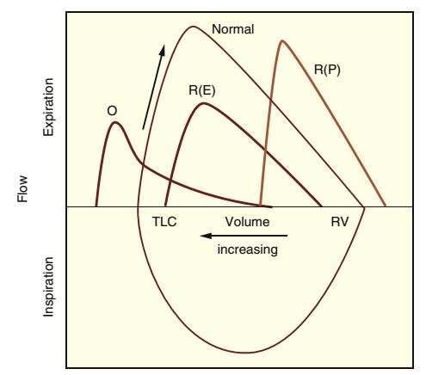
Restrictive lung disease (RLD)

Slide 99
Present unique challenges intra & postoperative care of patients
Cardiac, thoracic & vascular surgeries with RLD produce periop respiratory compromise on the patients
Its associated with higher mortality & morbidity
Affects lung expansion & compliance
Czd by: ↓ in all lung volumes specially TLC, ↓ in lung compliance & preservation of expiratory flow
Hallmark is inability to increase lung volume in proportion to an increase in pressure in the alveoli

Slide 100
Caused by
These can be due to:
Connective tissue diseases
Environmental factors
Other conditions that lead to pulmonary fibrosis
Any conditions that increase alveolar or interstitial fluid
Any conditions that limit appropriate excursion of the chest/
diaphragm during breathing

Slide 101
Leads to
Reduction in available surface area for gas diffusion
V/Q mismatching & hypoxia
Inability to clear lung secretions
Hypoventilation
reduced FEV1 & forced vital capacity (FVC)
Normal or increased FEV 1/FVC ratio
A reduced DLCO

Slide 102
Classification
TLC is used to classify RLD as
Mild disease - a TLC that is 65%– 80%
Moderate - a TLC that is 50%–65%
Severe by a TLC that is < 50%

Slide 103
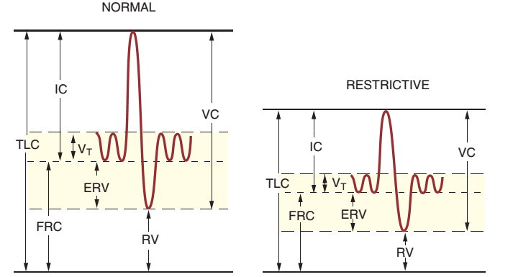

Slide 104
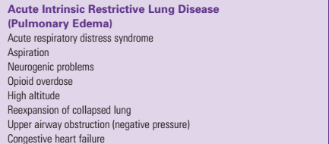
Classification based on - cause

Slide 105
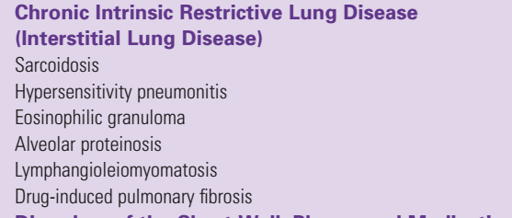

Slide 106
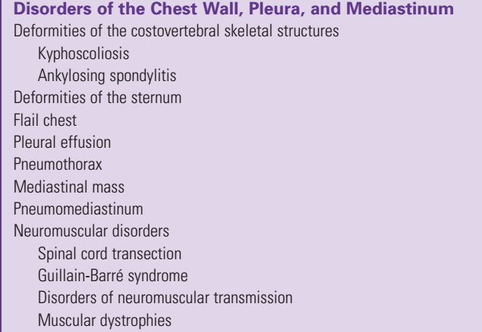

Slide 107


Slide 108
Pulmonary edema (PE)
The leakage of IV into the interstitium & the alveolar space leads to pulmonary edema
Acute pulmonary edema can be caused by:
↑ Capillary pressure (hydrostatic or cardiogenic pulmonary edema)
↑ Capillary permeability
Both of these lead to a condition called capillary stress failure

Slide 109
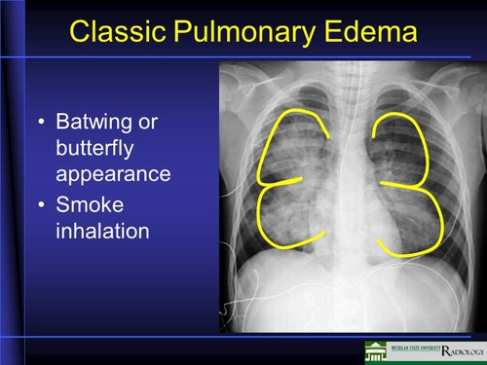
Increased capillary pressure PE
Pulmonary edema typically appears as bilateral, symmetric perihilar opacities on chest radiography
Butterfly fluid pattern is more commonly seen with ↑ capillary pressure
high concentration of protein & secretory products in the edema fluid

Slide 110
Increased capillary permeability PE
The presence of air bronchograms suggests increased-permeability pulmonary edema
Diffuse alveolar damage is typically present with the increased-permeability pulmonary edema associated with ARDS

Slide 111
Cardiogenic pulmonary edema
Cardiogenic PE is czd by:
Dyspnea
Tachypnea
Signs of sympathetic nervous system activation (hypertension, tachycardia, diaphoresis)
More pronounced than that seen in patients with increased permeability PE

Slide 112
Causes
Decompensated CHF - elevated cardiac pressures
Diastolic or systolic heart failure
Aortic regurgitation & acute mitral regurgitation – acute ↑preload
Ventricular outflow tract (LVOT) obstruction
Mitral stenosis
Reno-vascular hypertension - ↑ after load & SVR

Slide 113
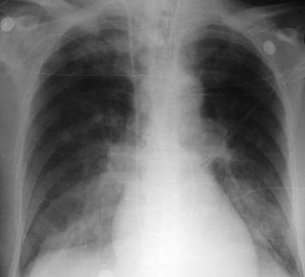
Radiograph shows acute pulmonary edema in a patient who was admitted with acute anterior myocardial infarction. Findings are vascular redistribution, indistinct hila, and alveolar infiltrates

Slide 114
Negative pressure pulmonary edema (NPPE)
NPPE follows the relief of acute upper airway obstruction.
It is also called post-obstructive PE
It is caused by:
Post-extubation laryngospasm
Epiglottitis
Tumors
Obesity
Hiccups
Obstructive sleep apnea in spontaneously breathing patients

Slide 115
Spontaneous ventilation is necessary to create the marked negative pressure that causes this problem
The time to onset of PE after relief of airway obstruction ranges from a few minutes to as long as 2 - 3 hrs.
Tachypnea, cough & failure to maintain oxygen saturation > 95%
Confused with pulmonary aspiration or pulmonary embolism
Common with postop desaturation

Slide 116
Pathogenesis
Obstructed upper airway vigorous inspiratory effort
High negative intrapleural pressure reverse Valsalva maneuver
↓ the interstitial hydrostatic pressure, ↑venous return & ↑ left ventricular afterload intense sympathetic nervous system activation trans-capillary pressure gradient PE

Slide 117
Treatment
Maintenance of a patent upper airway
Administration of supplemental oxygen
Mechanical ventilation
Hemodynamic monitoring
Central venous pressure and pulmonary artery occlusion pressure are also normal
Radiographic evidence lasts briefly

Slide 118
Neurogenic pulmonary edema
Occur in patients experiencing acute brain injury
Minutes to hours after CNS injury
Manifest during the perioperatively
Massive outpouring of sympathetic impulses from the injured CNS
Leads to generalized vasoconstriction & a shift of blood volume into the pulmonary circulation
Transudation of fluid into the interstitium & alveoli
increased pulmonary capillary pressure
Chemical pneumonitis is DDx – but lasts longer & complicated by bacterial infection

Slide 119
Re-expansion pulmonary edema
Rapid expansion of collapsed lung
After relief of pneumothorax or effusion
Risk depend on the volume of space occupying entity, duration of collapse & rate of re-expansion
Enhanced capillary membrane permeability – high protein content
Treatment is supportive

Slide 120
Reading assignment
Drug induced pulmonary edema
High altitude pulmonary edema

Slide 121
Management of Anesthesia
Elective surgery should be delayed
Every effort must be made to optimize cardiorespiratory function before surgery
Large pleural effusions may need to be drained.
Persistent hypoxemia may require mechanical ventilation & PEEP
Hemodynamic monitoring may be useful in both the
Assessment & treatment of pulmonary edema
PE patients are critically ill

Slide 122
Intraoperative management should be a continuation of critical care management
Plan for intraoperative ventilator management
Ventilate with low tidal volumes - 6–8 mL/kg
Ventilatory rate of 14 to 18 bpm
Keep the end-inspiratory plateau pressure at less than 30 cm H2O
Careful titration of PEEP in conjunction with inspiratory pause is recommended to optimize lung compliance

Slide 123
Patients with restrictive lung disease typically have rapid, shallow breathing
Tachypnea is likely during the weaning process and should not be used as the sole criterion for delaying extubation if gas exchange and results of other assessments are satisfactory

